Slide 1
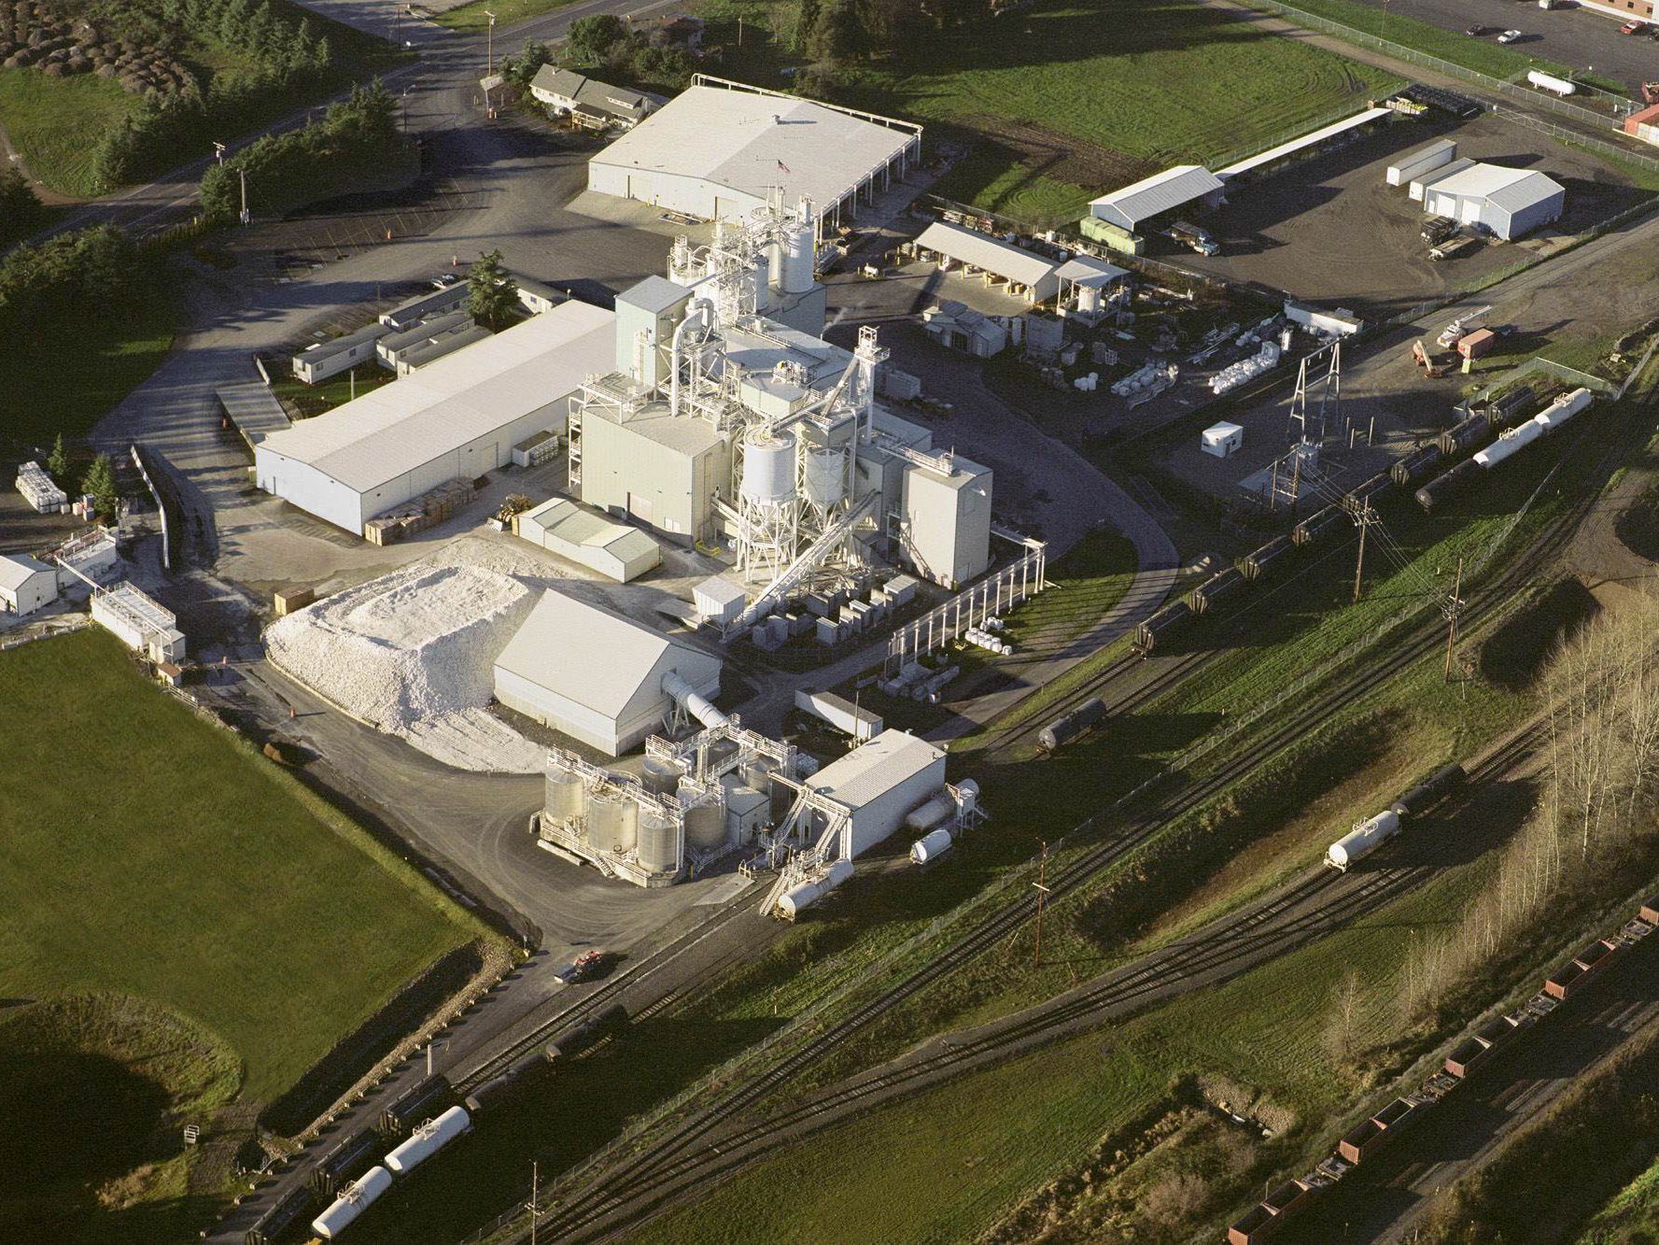
Agenda…..
  CaCO₃ – What is it?
  Typical Product Applications…
  Company Introduction
  Raw Material Supply History
  Importance of the Marine Terminal
      To CRC & the Local Community
  Request the School District’s Support

Slide 2
CaCO₃ – Quick Lesson

Slide 3

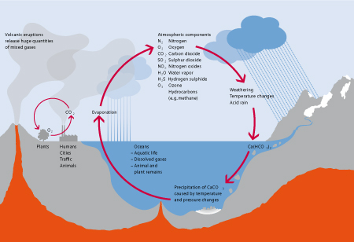
What is Calcium Carbonate?
Where Does it Come From?

Slide 4

In Fact the Skeletal Structure is
100% Calcium Carbonate

Slide 5
Markets Served

Slide 6
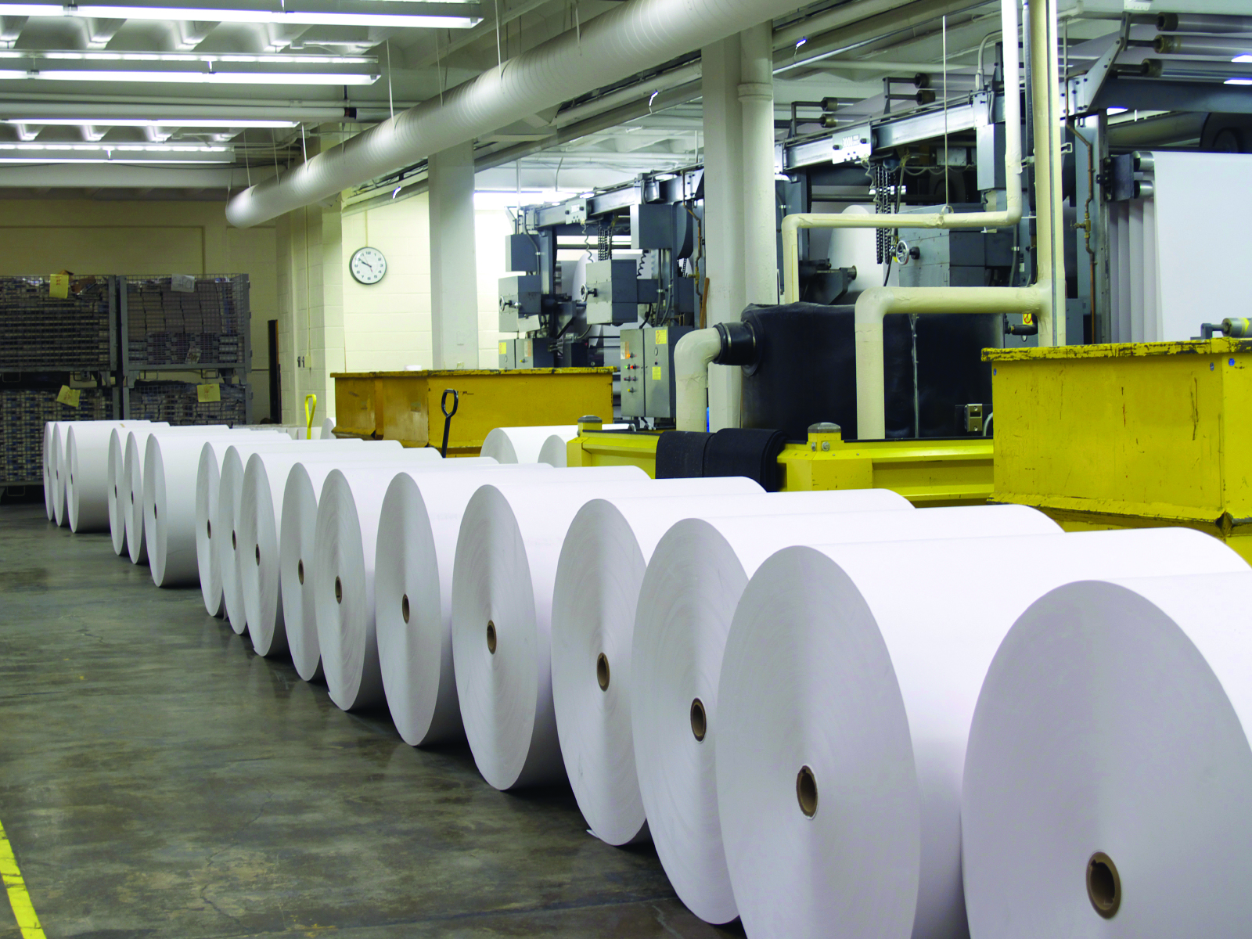





Slide 7




Slide 8
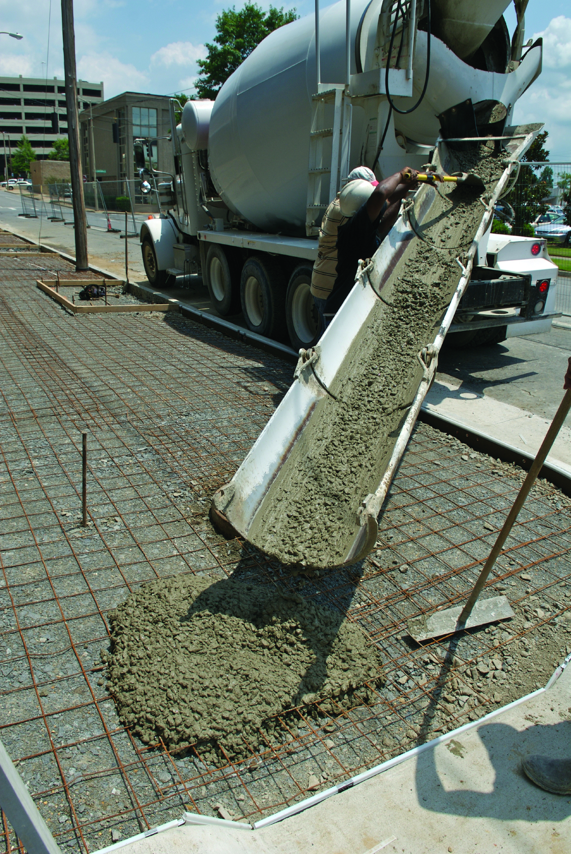
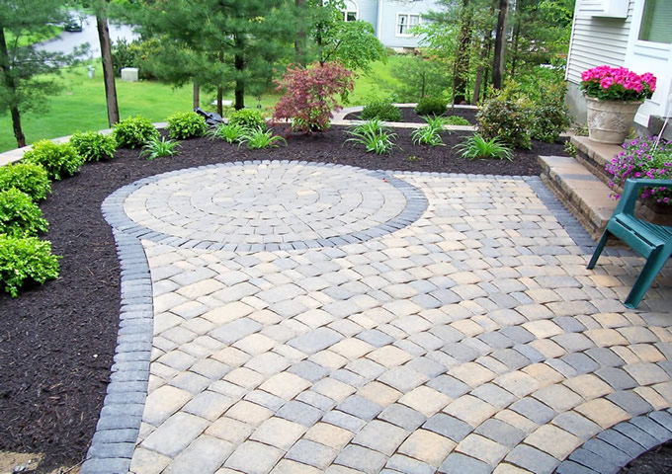


Slide 9


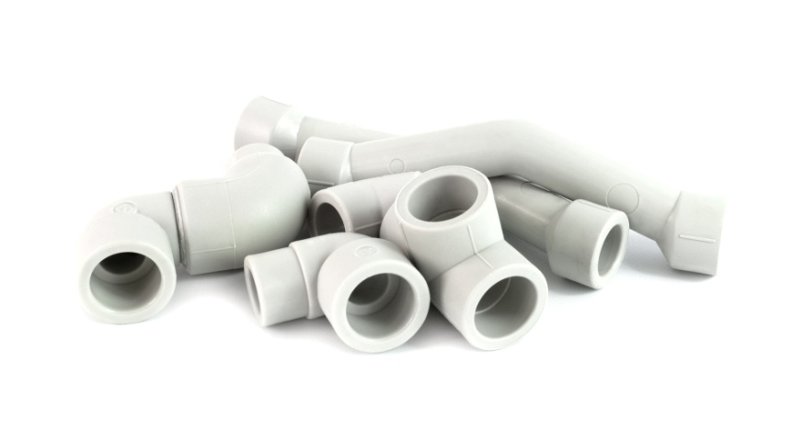



Slide 10




Slide 11
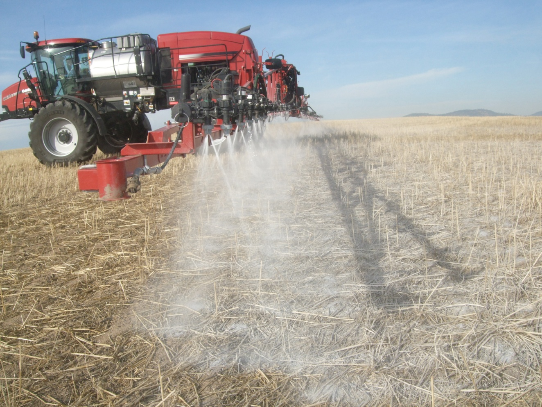


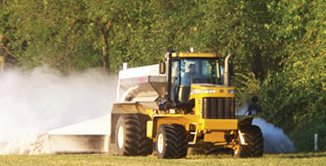

New Focus

Slide 12
CRC Overview

Slide 13
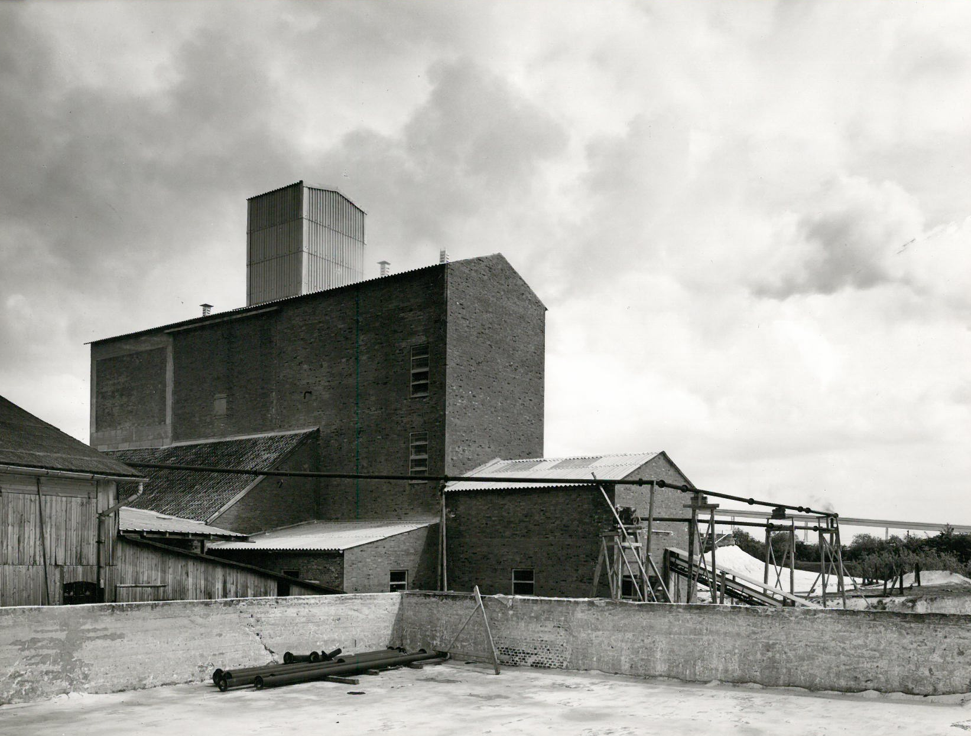
Bleeck Management, Inc.
  Founding Partner
  Family in the CaCO₃ Since 1870
      Washington – 1985 – Current
  Entrepreneur and Vision
  Long – Term Focus/Commitment
  Reinvestment of Profits

Slide 14
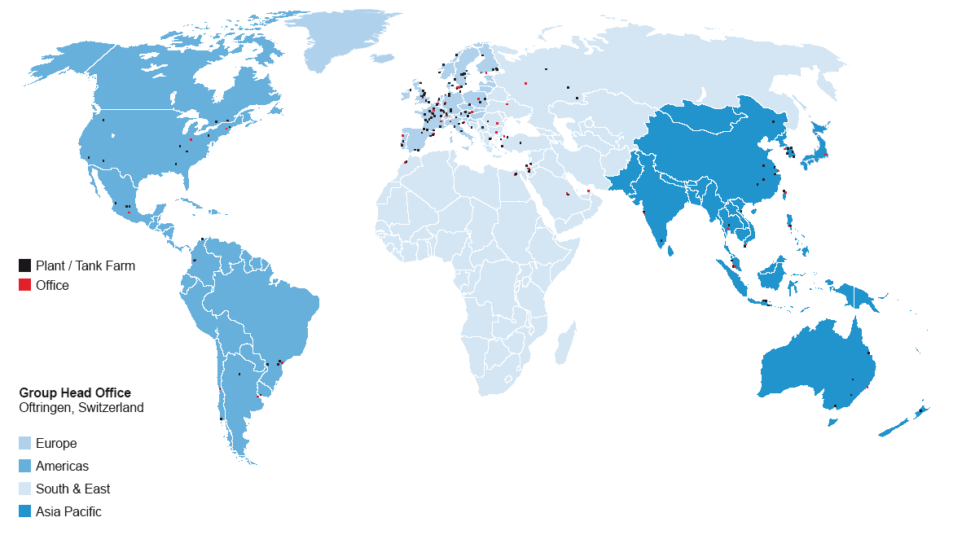
OMYA’s – Global Reach
    Sales Revenues 3.0 Billion CHF 100 Countries
    Employees 7,500 Employees
    Deposits & Plants 50 countries

Slide 15
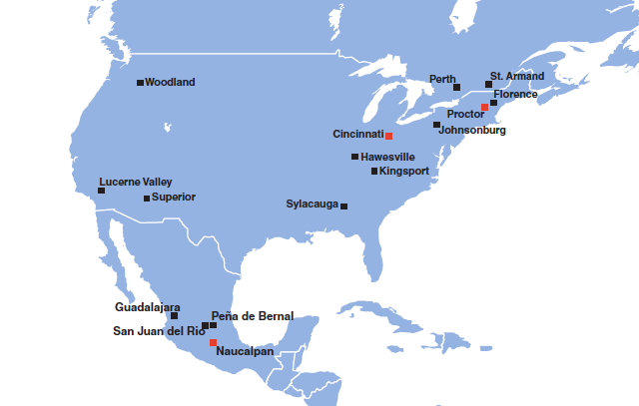
OMYA – Region Americas
Major World Producer of CaCO₃
      CaCO₃ Core Business

Slide 16
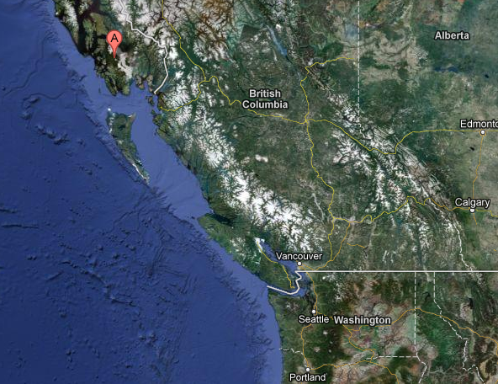
Raw Material Sourcing
6 Strategic Locations
Mine Site
Calder Bay, AK
Quarry, Wauconda, WA
La Farge
Texada Island BC
Quarry, Wauconda, WA
Rail Site
Janis, WA
Rail Site
Janis, WA
Plant
Woodland, WA
Plant
Woodland, WA

Slide 17
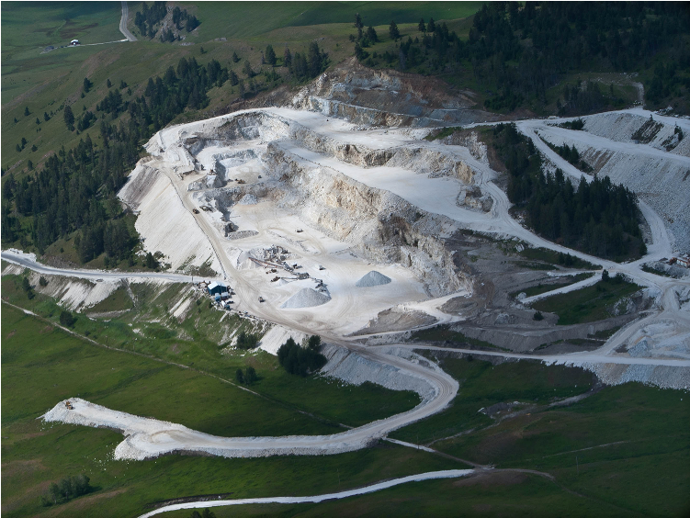
Wauconda Crushing Operation
  Active Since 1986
  900 Acres of Land Holdings
  Seasonal Operation (Apr-Oct)
  Current Minable Reserves1-2 Million tons
  Contractor Operated -25 Employees
  Stable Variable Cost Since 2000 (15%)
  Estimate Remaining Life +/- 5 years
  Investments of $4.5 Million

Slide 18
Quarry, Wauconda WA

Slide 19
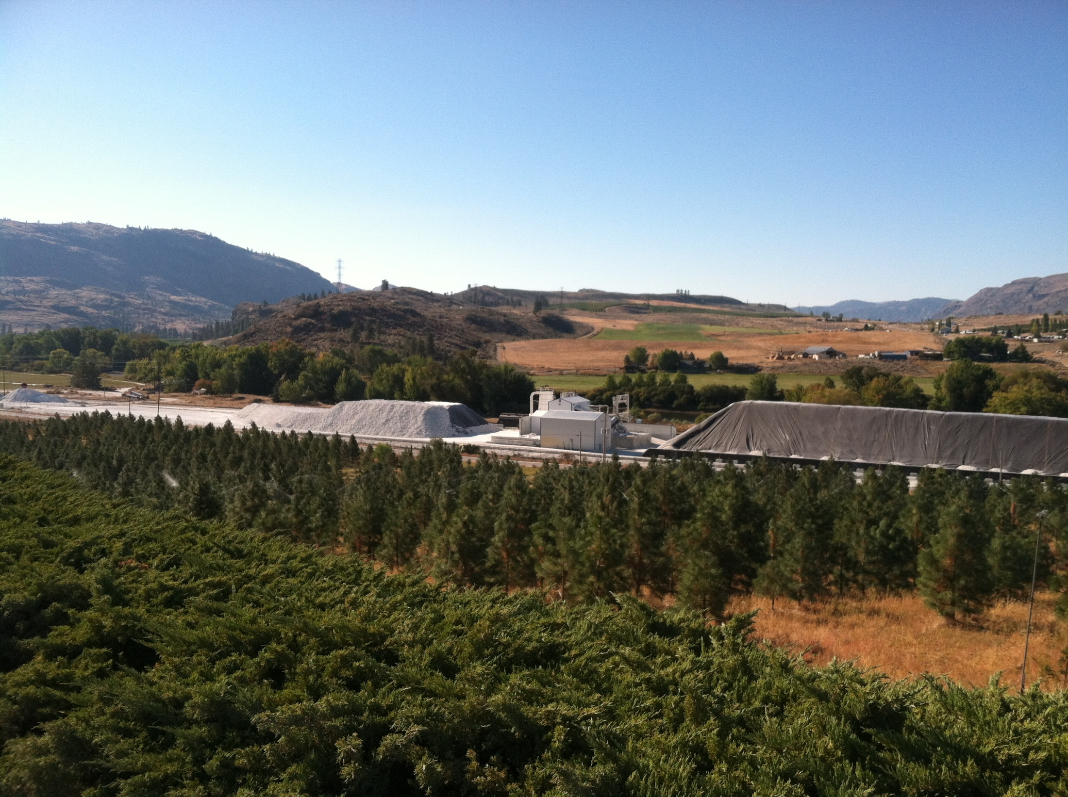
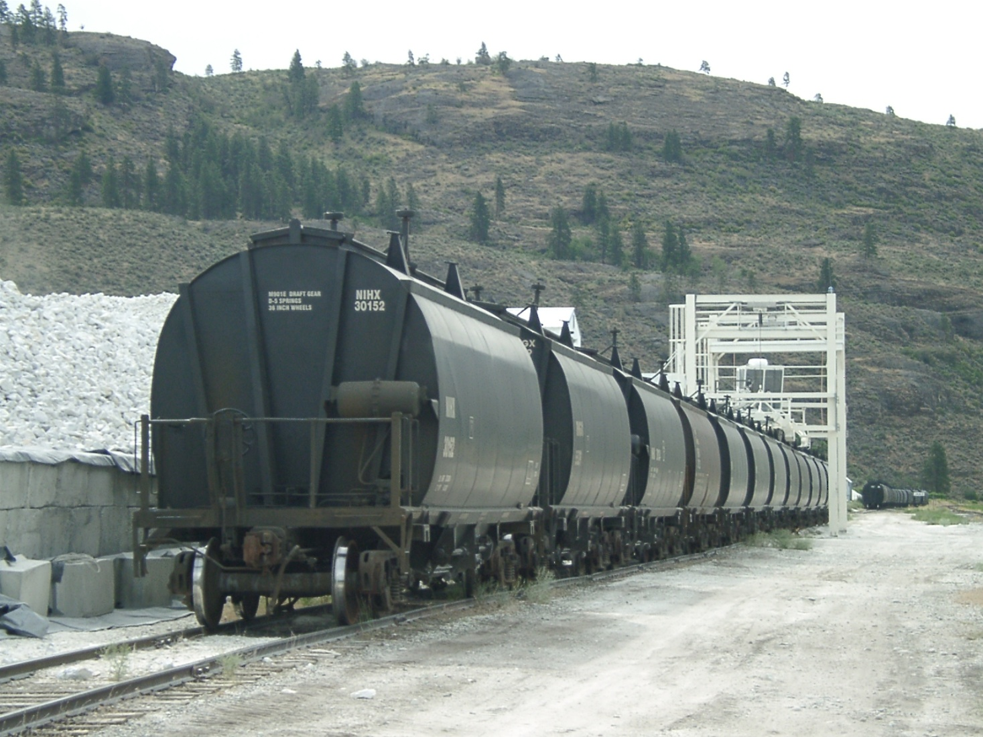
Janis Rail Facility
  33 Miles From Wauconda
  Raw Material is Trucked In
  70 Acres of Land Holdings
  Year Round Operation
  Screening and Rail Loading Facility
  90 Privately Leased Covered Rail Cars
  All Loading Equipment is Designed for these Cars
  Stable Variable Cost Since 2000 (15%)

Slide 20
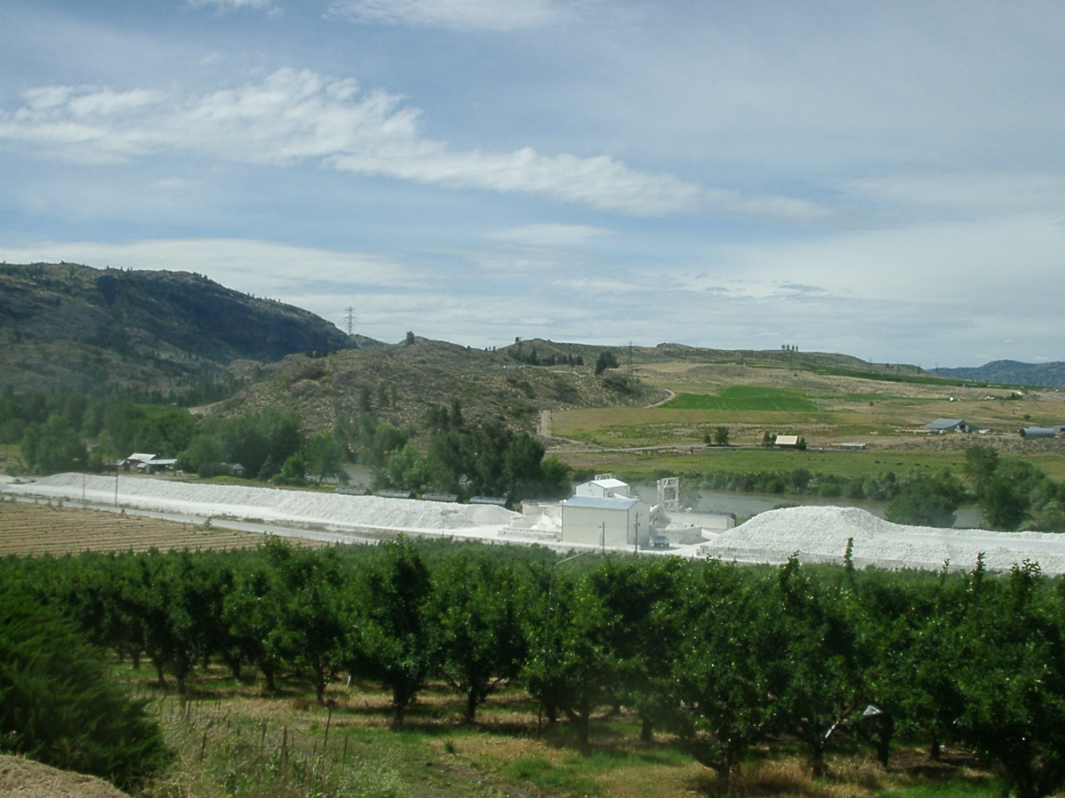
Rail Site -Reload, Janis WA

Slide 21
Woodland Operation
  Operational Since 1985
  365 Days/24 Hours Facility
  65-70 Employees (incl. AK)
  Investments > $80 Million
  Annual Sales Revenue $31 Million
  Rail Service/Cost – Increasing Concern
  Limited Raw Material Supply
    NE Washington Raw Material
  Need for Raw Material Alternatives

Slide 22
Woodland Operation

Slide 23
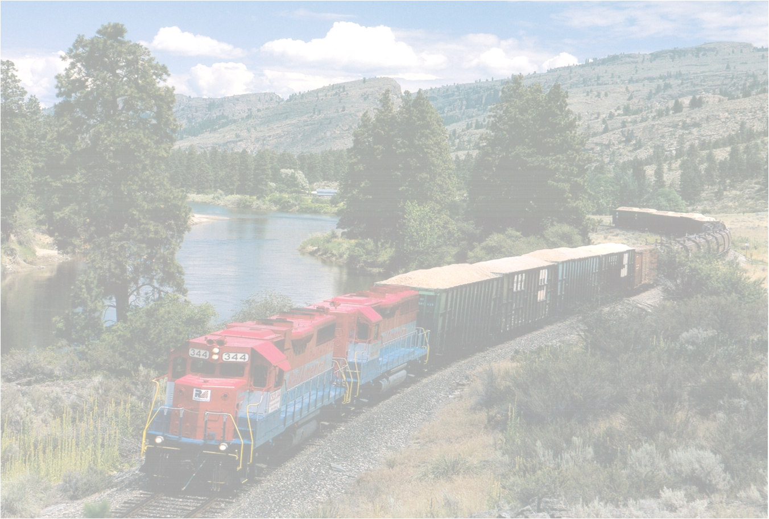
Operational Limitations w/ Rail
(Raw Material Sourcing)
Year | Sales | BNSF | % of Sales | Lafarge
2002 | 148,071 | 150,492 | 102% | 0
2003 | 139,300 | 139,066 | 100% | 0
2004 | 161,665 | 156,353 | 97% | 0
2005 | 174,295 | 171,418 | 98% | 0
2006 | 182,439 | 178,967 | 98% | 0
2007 | 183,317 | 176,644 | 96% | 0
2008 | 193,378 | 205,939 | 106% | 13,000
2009 | 173,267 | 165,670 | 96% | 0
2010 | 183,179 | 153,605 | 84% | 49,800
2011 | 205,075 | 124,595 | 61% | 62,500
2012 | 205,700 | 151,104 | 73% | 25,000

Slide 24
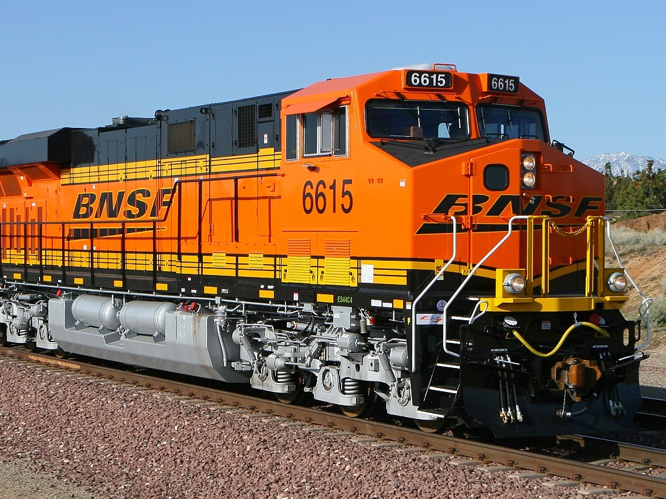
Operational Limitations w/ Rail
(Raw Material Sourcing)

Slide 25
Operational Limitations w/ Rail
(Rail America a Short Line)
  Rail America – Small independent Rail Carrier
    Link between Janis Site and BNSF Wenatchee
    Substantial Loss of Customer Base 2008
    CRC Is now RA’s Largest Customer
    2008 Service from RA Starts to Erode
    Long – Term Viability is of Concern

Slide 26
Operational Limitations w/ Rail
(Rail America Considerations)
?

Slide 27
Operational Limitations w/ Rail
(BNSF Considerations)
  BNSF Routing Changes
      Janis – Cascade Tunnel – Woodland
      Janis - Spokane – Woodland
  Issues at Various Switching Yards
  Added an additional 4-6 days/round trip
  Average Reduced Fleet Capacity > 25%
  Max Reduced Fleet Capacity ~ 40%
      (2011) 200K tons → 155K tons

Slide 28
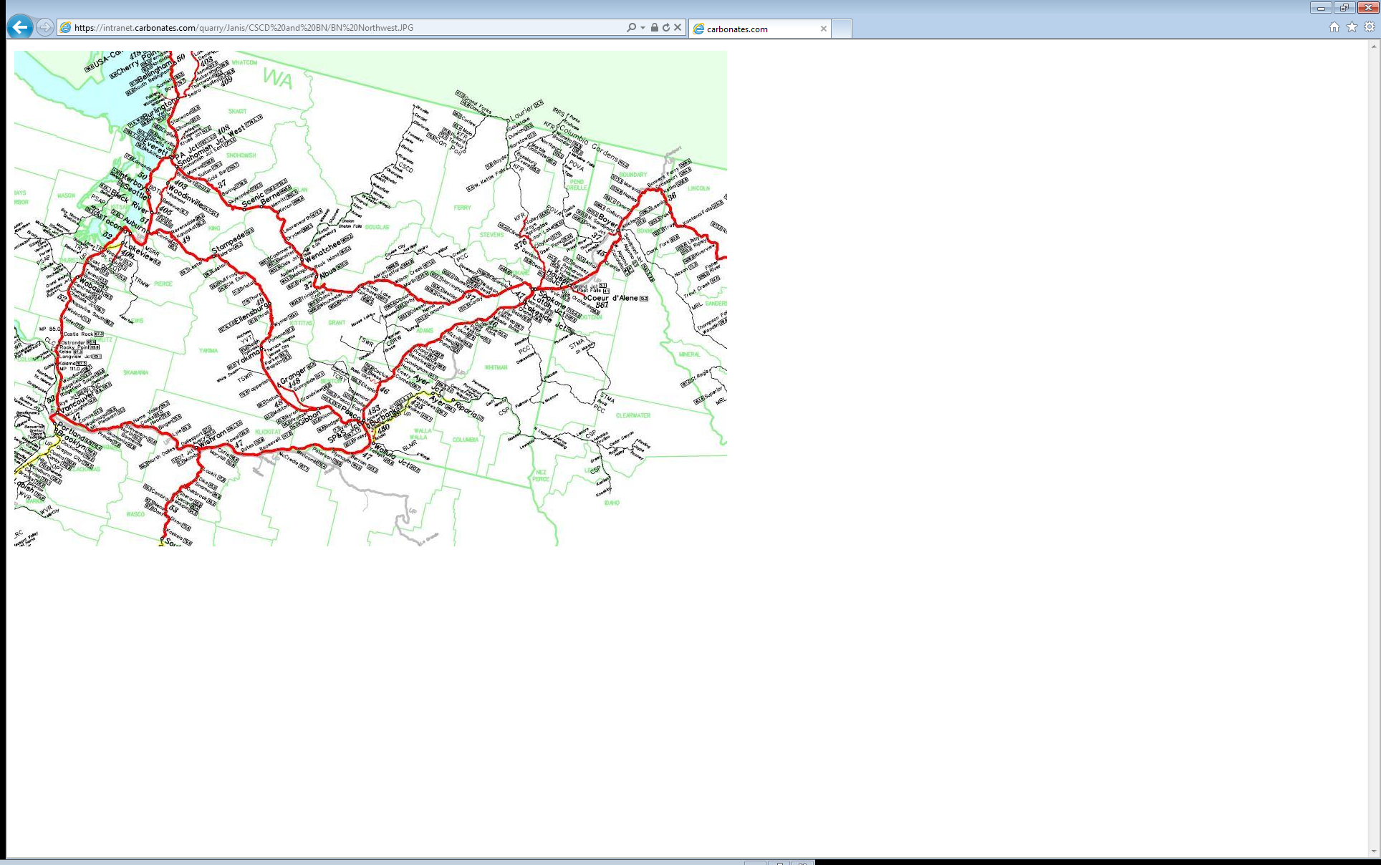
BNSF Routing Changes

Slide 29
Variable Cost Trends 2000-2012
(Wauconda Stone)
15%
78 %

Slide 30
Impact of Eroding Rail Service - CRC
(Operational Limitations w/ Rail)
  Financial Impact of Eroding Service
      $5.00 $/t Increase – Fixed Costs
      Capital Spending and Working Capital
        Additional investments of $7.0 million (AK)
      Increased Logistical Challenges
  Operational Impact of Eroded Service
      Potential Loss of Customers
      Need for New Stone Sources

Slide 31
Raw Material Sourcing
6 Strategic Locations
Mine Site
Calder Bay, AK
Quarry, Wauconda, WA
Quarry, Wauconda, WA
Rail Site
Janis, WA
Rail Site
Janis, WA
Plant
Woodland, WA
Plant
Woodland, WA

Slide 32
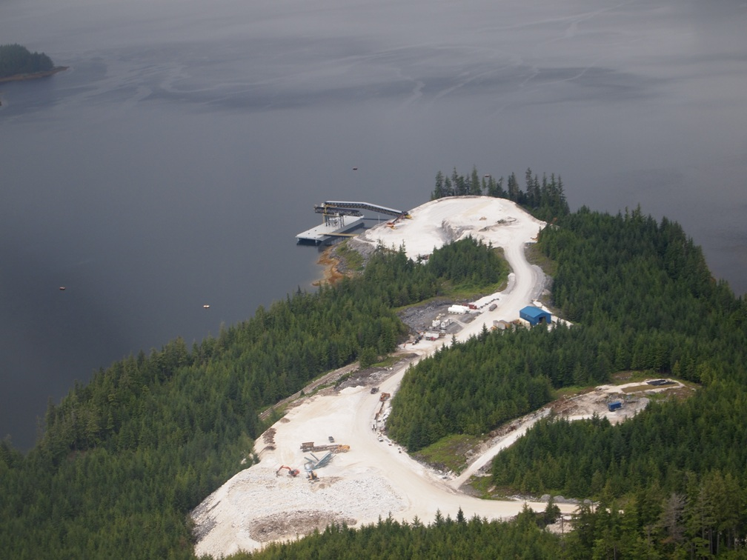
Quarry - Calder Bay, AK

Slide 33
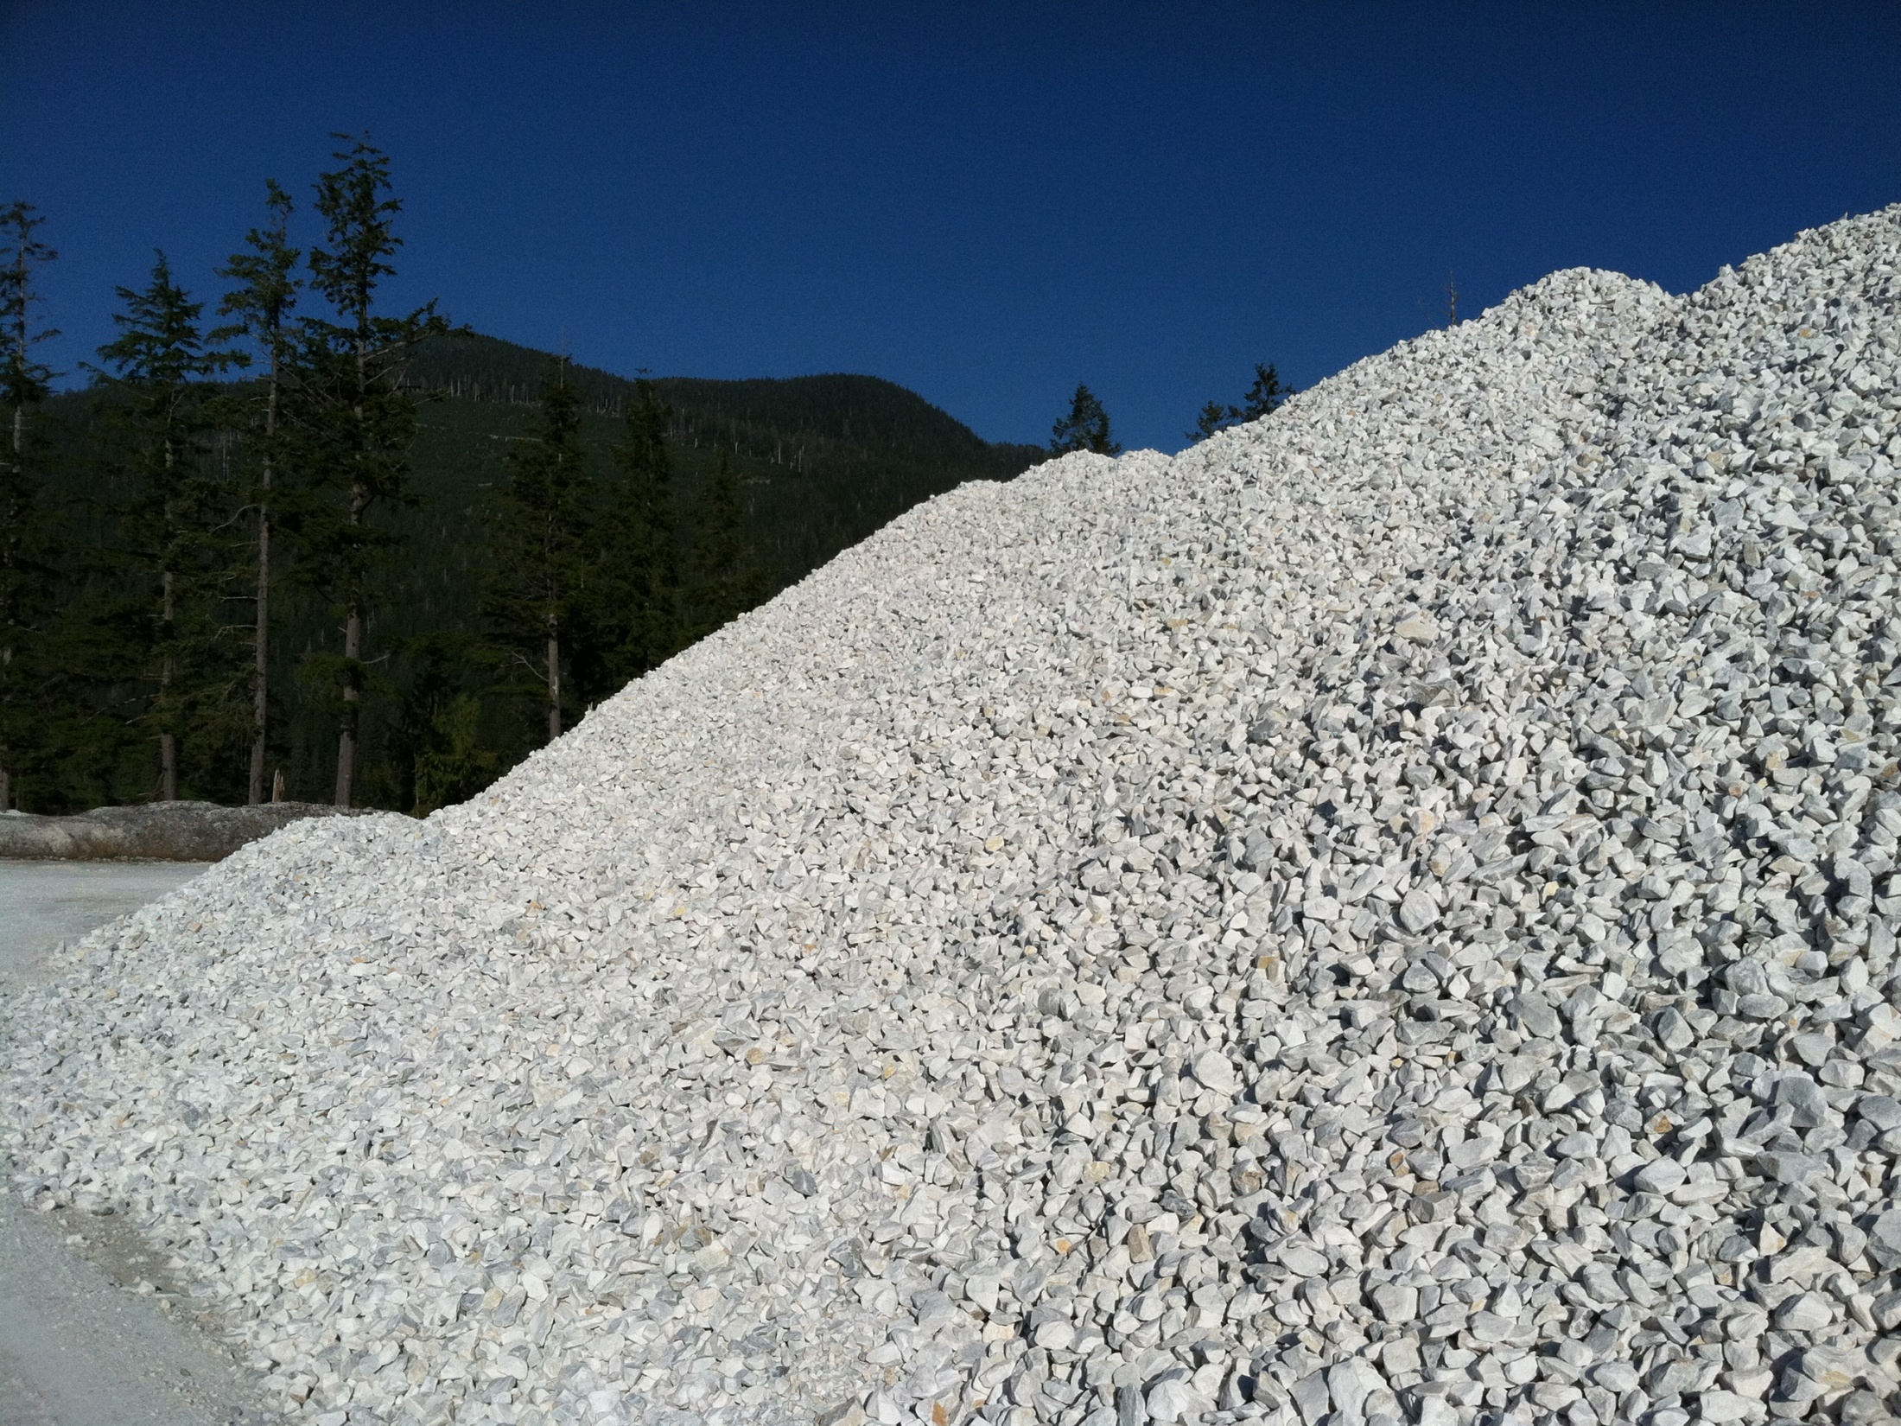
Quarry - Calder Bay, AK

Slide 34
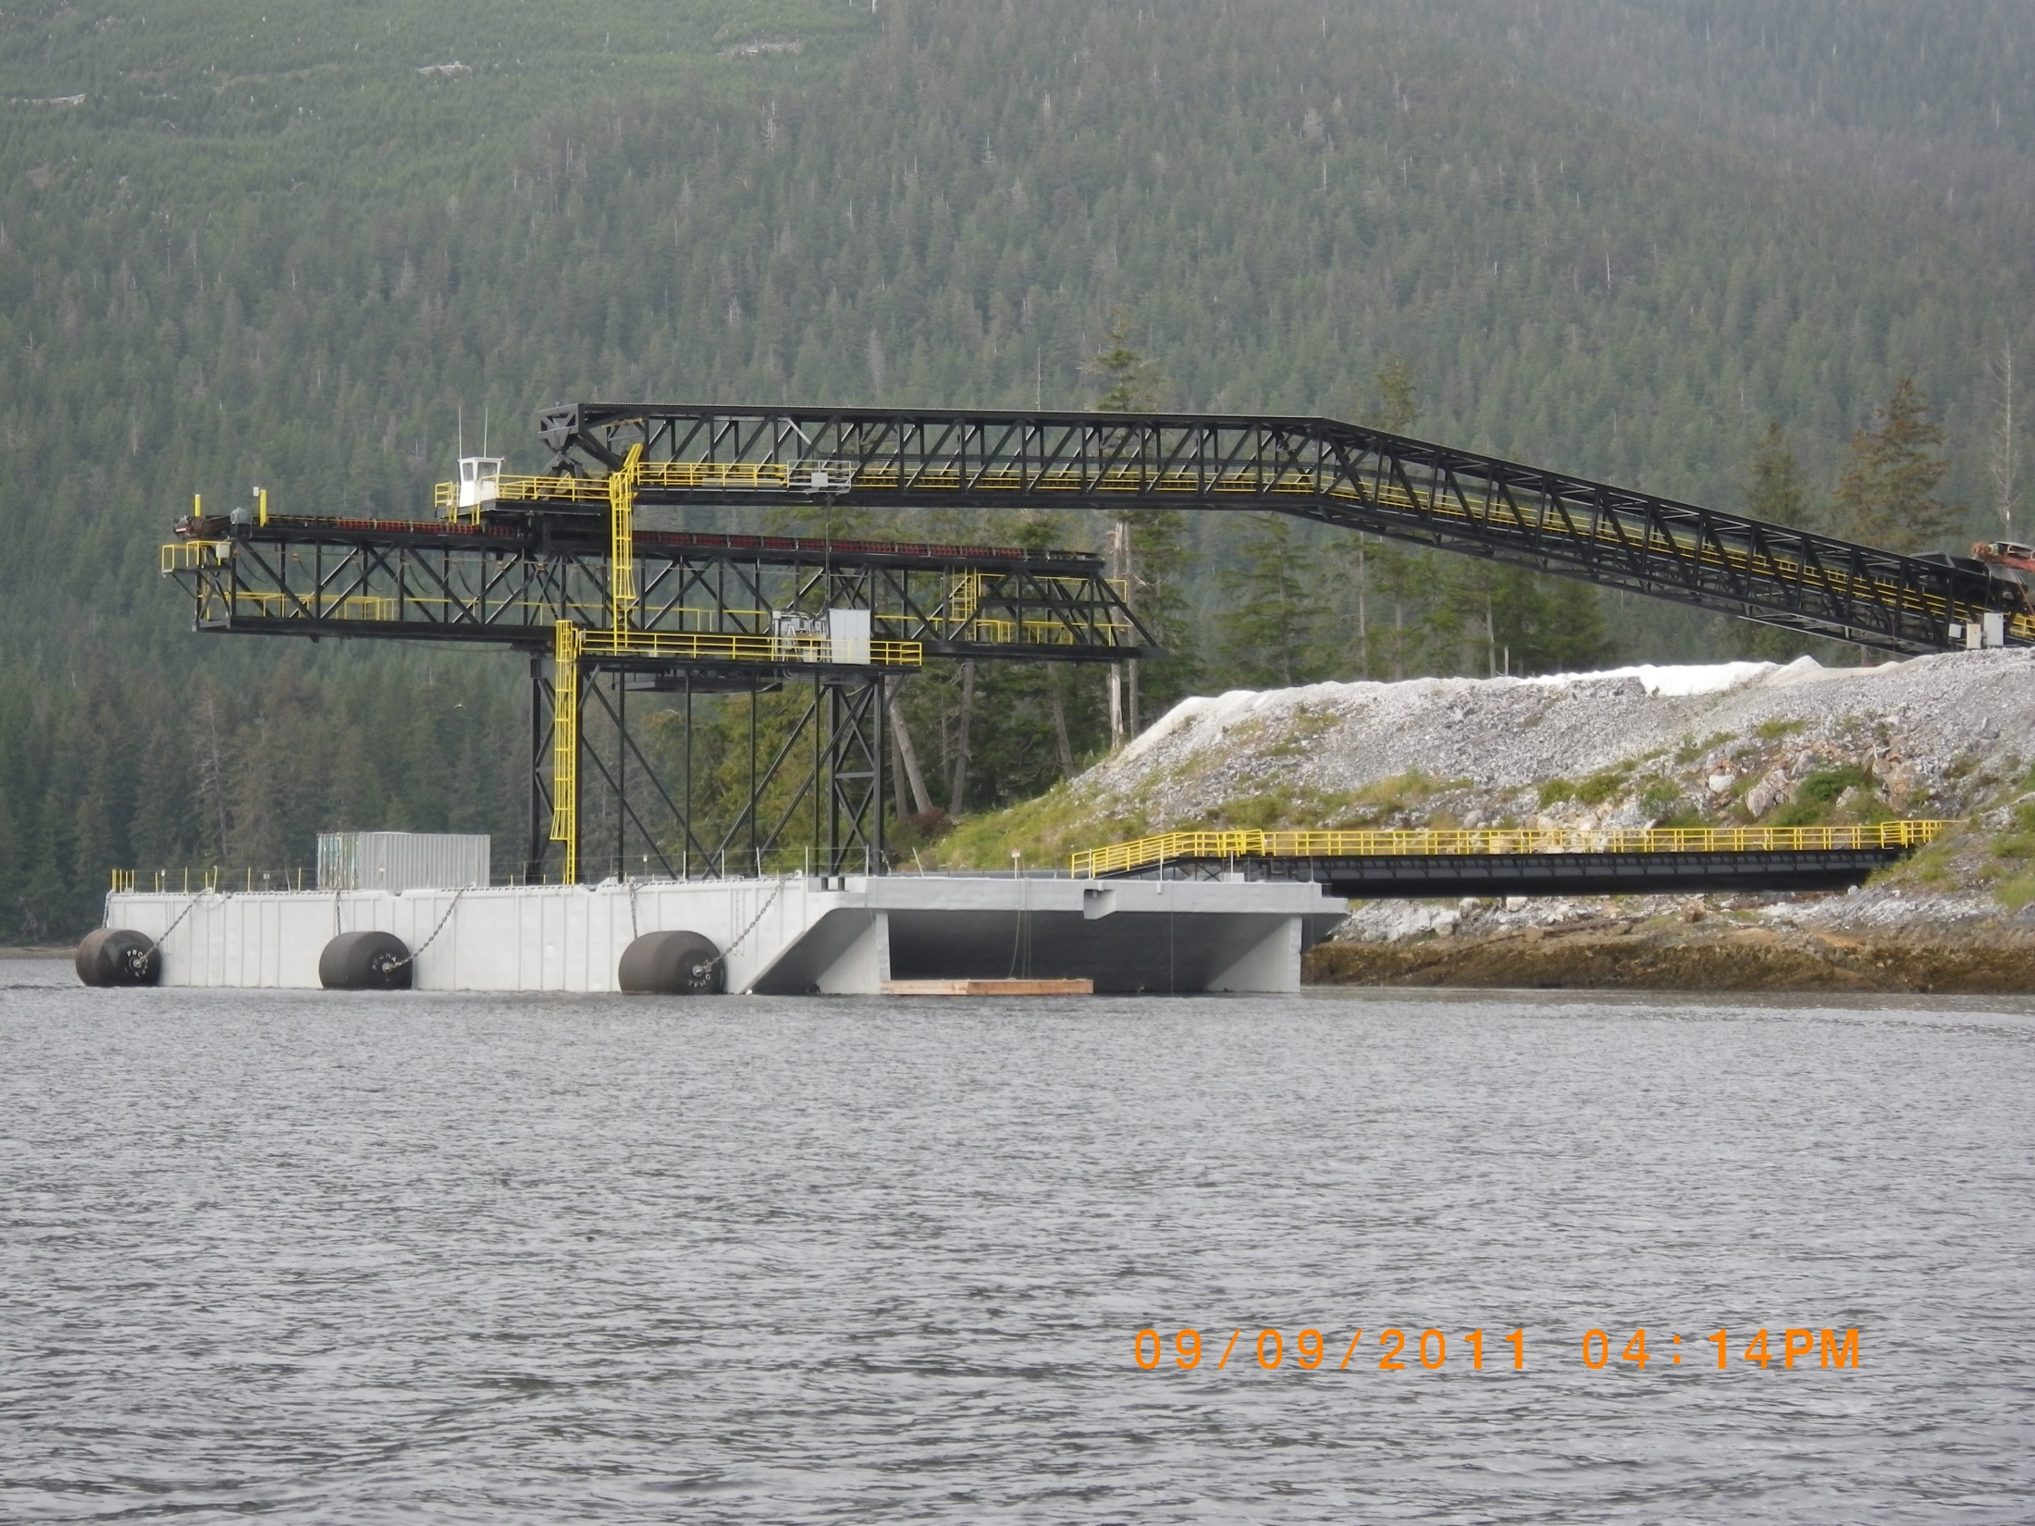
Quarry - Calder Bay, AK

Slide 35
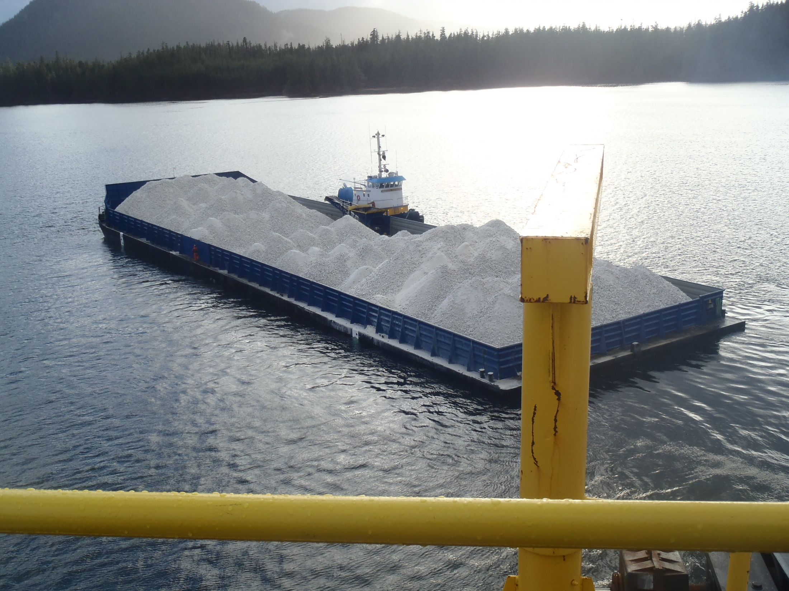
Quarry - Calder Bay, AK

Slide 36
CRC Financial Considerations

Slide 37
Key Financial Considerations
  Historically – CRC Sales Concentrated in Paper
  Over the last 10 years
      CRC has Lost 4 Paper Accounts
      Volumes nearly 80 K tons Annually
      Sales Revenue loss of $15 million
      Margins on Slurry Greater than Dry Sales
  Diversification of Sales – Business Critical
      New Dry Markets Extremely Low Pricing
      In Several cases < $55/ton
      Low Raw Material Costs are business Critical

Slide 38
Sales vs. Profitability
  Since 1998
  Sales Up 80,000 tons
  Profitability Down 50%

Slide 39
Paper Industry Sales – The Reality
  Paper Accounts – Most are Struggling
  Paper Usage Continue a Downward Trend
  Recovery of Cost Increases is Nearly Impossible
  Average Slurry Margins Down 25%
  Continued Risk of Lost Accounts / Margins
  New Paper Business – Difficult to Attain
  New Paper Sales – Greater Risk

Slide 40
Summary
  Rail Rates Have Increased Dramatically
      Over 80% in the last 10 years
  Rail Focus has Shifted to Unit Trains of Coal/Grain
      Service Continues to Erode Dramatically
      Resulting in a $5.00/ton Increase in Fixed Unit Cost
      Annual Impact of Service ($1,000,000) Annually
  CRC Remains Committed to Wauconda
      Available Reserves are Limited – 5 +/- years
      But it has to Make Sense Financially
  CRC Has a Viable Raw Material Alternative
      Marine Terminal is Business Critical

Slide 41
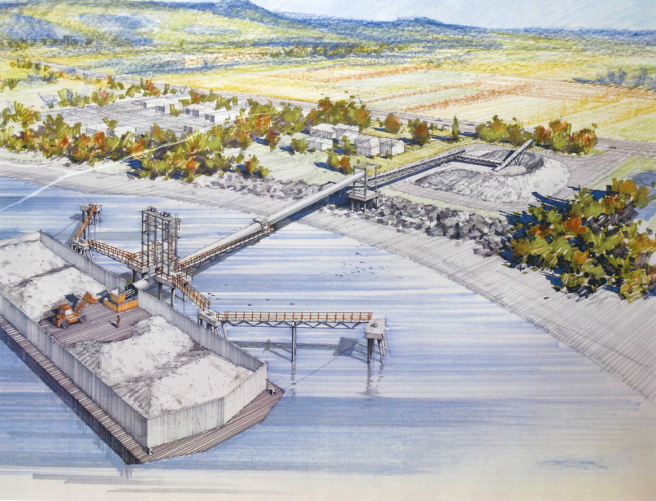
CRC – Marine Terminal
  2013 – CRC Barged > 80,000 tons
  Currently Material Shipped to Rivergate PDX
    Ashgrove – A Competitor
    CRC Pays a Storage and Transfer fee
    CRC Trucks the Material 25 miles
    CRC Incurs Substantial Additional Cost

Slide 42
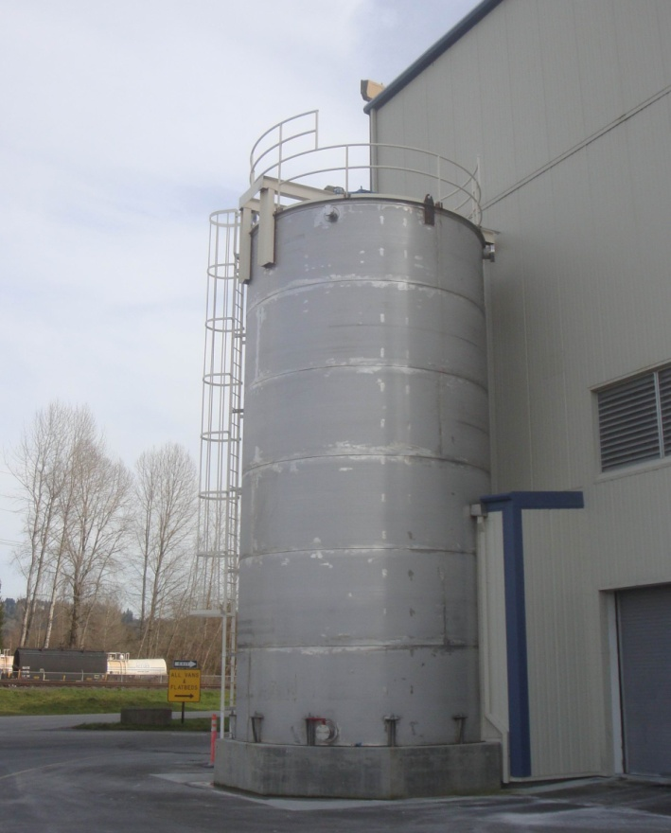
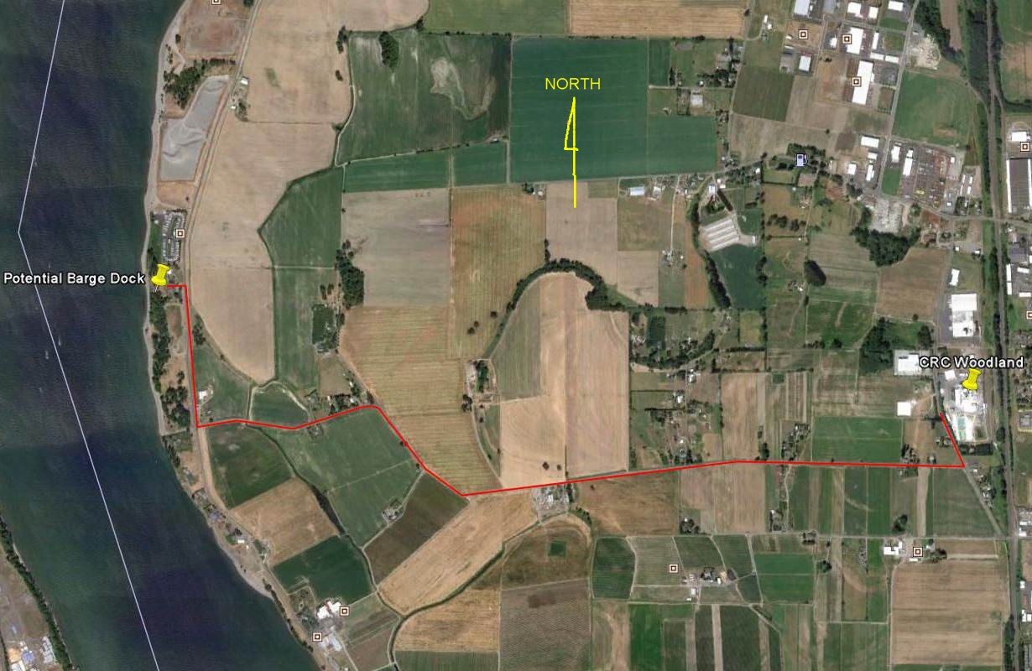
Marine Terminal Engineering & Permitting

Slide 43
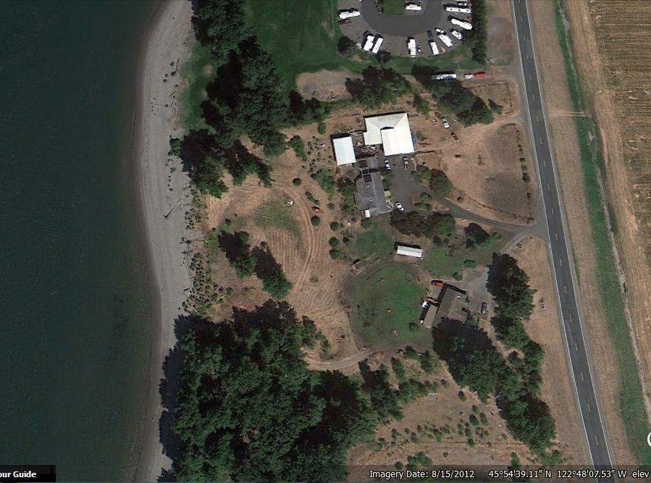
Marine Terminal Engineering & Permitting

Slide 44
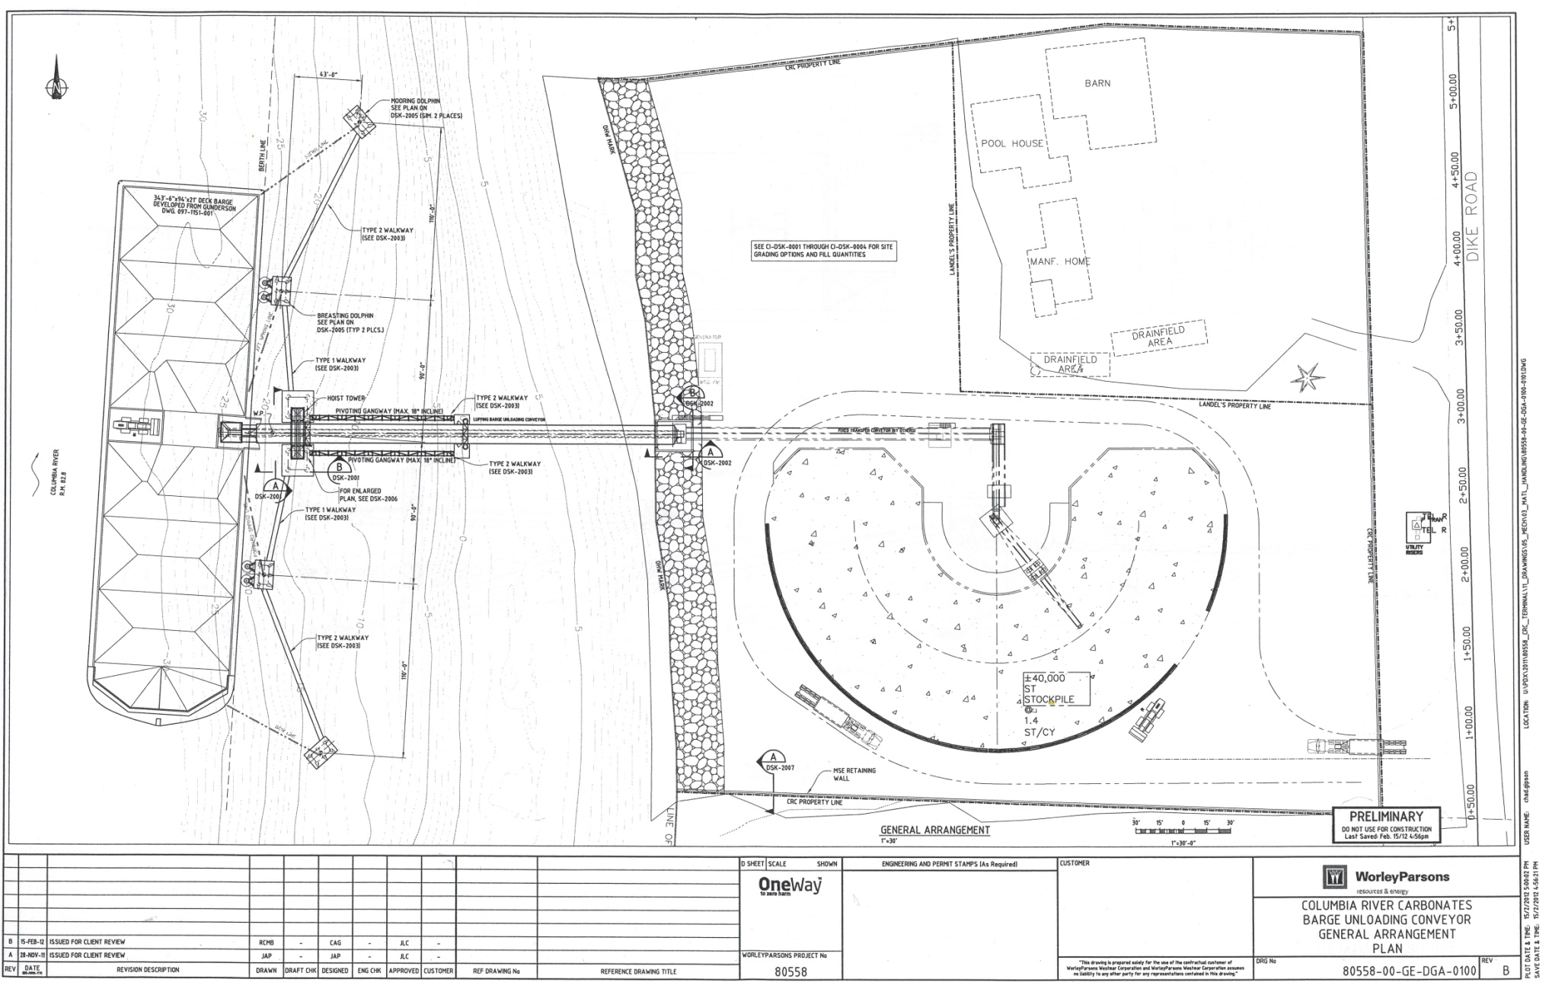
Marine Terminal Engineering & Permitting

Slide 45
CRC – Marine Terminal

Slide 46
Marine Terminal – Current Status
  Subject Property Designated as Heavy Industrial
    Marine Terminal is an Allowed Use
  CRC has Submitted Required Permit Applications
  To Date CRC has Invested $400,000 in 3-years
    To Address Environmental Impacts
  Primary Permitting Agencies
    Cowlitz County
    US Army Corps of Engineers
  Estimated 3 +/- Years in Permitting

Slide 47
Marine Terminal – Local Impact
  At Full Operation (5-10 years out)…...
    2-5 days/Month Barge Unloading (Max)
    30 Truck Trips/Day (Max)
  Investment of > $10,000,000 in Marine Terminal
  Preservation of 70 +/- Family Wage Jobs
  Preservation of Current Tax Base ($345 K Current Tax Revenues)
  Creation of new Tax Base ($140 K Future Tax Revenues - Terminal)
  New Family Wage - +/- 5 jobs (Initially)
  Opportunity for CRC to Expand - Grey Powder

Slide 48
Grey Powder Markets – AGRO
  Agricultural Opportunities
    CRC Investment in Prilling Plant (Ag)
    Estimated Capital Investment of $11,000,000 +/
    New Family Wage - +/- 10-15 jobs

Slide 49
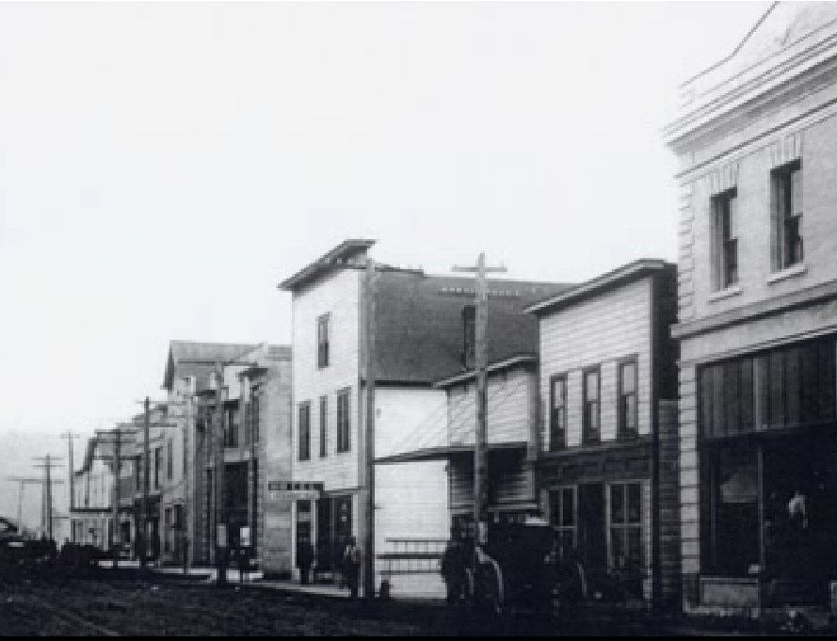
Marine Terminal – Potential Impact
  Short-Term
  Preservation of Local Tax Revenues of ~ $300K
  Preservation of Existing Jobs (+/- 70)
  Preservation of Local Scholarships of $14,000/year
  Long Term
  New Tax Base in Excess of $21,000,000
  New Local Tax Revenues of Potentially $300K
  New Family Wage Jobs Approx. 15-20

Slide 51
Answers
Questions
&

